Slide 1
Leadership Lessons from Toyota

Slide 2

Other Modules In This Series:
5S
Standard Work
Total Productive Maintenance (TPM)
Administrative Lean
Cell Design/ Production Preparation Process (3P)
Kaizen
Kanban
Problem Solving
Poka Yoke Quality Systems
Transaction Process Improvement (TPI)
Cause & Effect Diagram with the Additions of Cards (CEDAC)
Single Minute Exchange of Dies (SMED)
Value Stream Mapping (VSMi®)
Visual Management
Managing Daily Process Excellence
For More Information Please Contact:
Mark DeLuzio, President and CEO
+1.860.234.0915
mark.deluzio@leanhorizons.com
Strategically Creating Value Through the Elimination of Waste

Slide 3
This document contains confidential
and proprietary information owned
by Lean Horizons Consulting, LLC.
Any disclosure, use, copying or
distribution of this information without the express written consent of Lean Horizons Consulting is strictly prohibited.

Slide 4
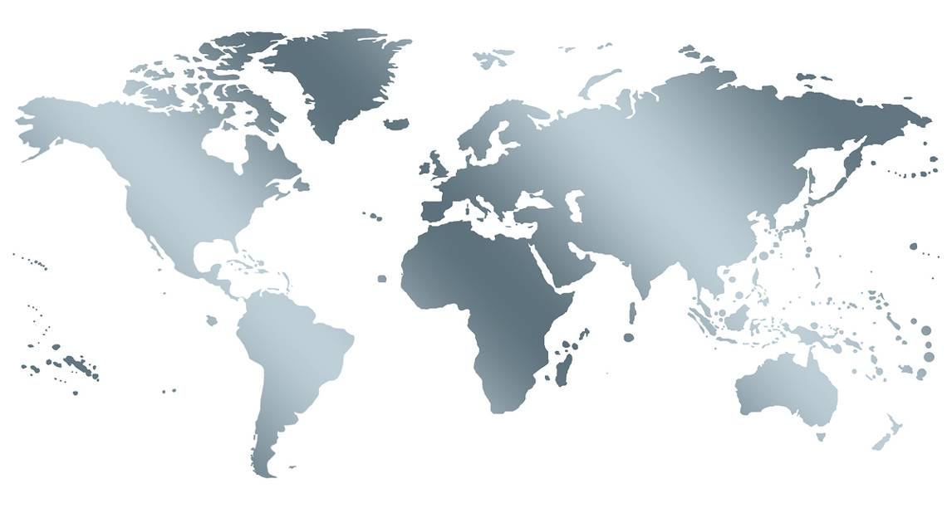
Lean Transformation Experience so far…
Lean will work anywhere
  Any industry
  Any location
  Any culture

Slide 5
Lean Transformation: from what to what?
Narrow definition:
Tools
Cost cutting
Broader definition:
Thinking, systematic
Entire enterprise, business system

Slide 6
Lean Transformation Experience so far…
Lean will work anywhere, but
  Many companies have tried…
  Not every company is successful…
  In fact, most aren’t…
WHY??

Slide 7
Every Organization Must Address
Points Descriptions
1
Purpose
Provide value to customers cost-effectively in order
to prosper
2
Process
Through primary value streams for design, make, use, and support streams
3
People
By engaging employees touching value streams (including support streams) to sustain and improve them
Defining purpose and specifying process while/by
aligning people is the central task of management
Reproduced with permission of John Shook, Lean Enterprise Institute

Slide 8

Lean Transformation Some Lessons Learned
Techniques ➔System➔ Thinking
Cherry-picking the tools is
not enough
The tools comprise a system
Integrated, holistic
Technical side, “soft side”
A way of thinking underlies the tools and system
Learn the thinking through doing
Reproduced with permission of John Shook, Lean Enterprise Institute

Slide 9

Most of the leader’s job at Toyota
Leadership Role
First, get each person
to take initiative to solve problems and improve his or her job
Second, ensure that each person’s job is aligned to provide value for the customer and prosperity for
the company
Third, develop his/her people
  “If the learner hasn’t learned, the teacher hasn’t taught”
Reproduced with permission of John Shook, Lean Enterprise Institute

Slide 10
Leadership: Three Models
Three Models Descriptions
1
Old “Dictator”
Style
“Do it my way…”
2
1970’s
“Empowerment Style”
“Do it your way…”
3
Lean Style
“Follow me… and we’ll figure this out together”
The lean leader leads by Kaikaku and Kaizen
“Lead the organization as if you have no power.”
- Kan Higashi and Gary Convis, NUMMI’s Senior Japanese and Senior American Leaders
Reproduced with permission of John Shook, Lean Enterprise Institute
Notes:
Kaikaku is the Japanese term for "radical change". In business, Kaikaku is concerned with making fundamental and radical changes, unlike Kaizen which is focused on incremental changes.

Slide 11
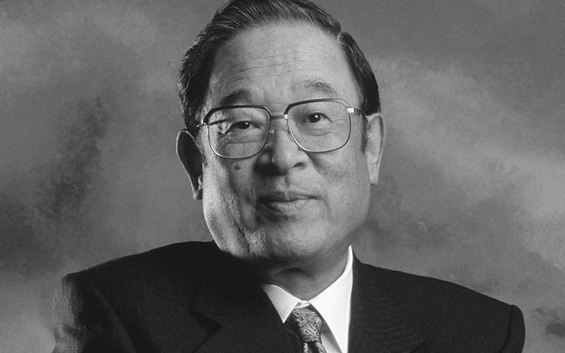
Chairman Cho of Toyota: Three Keys to Lean Leadership
Fujio Cho, Chairman of Toyota Motor Corp.
Go See
  “Senior Management must spend time on the front lines”
Ask Why
  “Use the “Why?” technique daily”
Show Respect
  “Respect your people.”
Reproduced with permission of John Shook, Lean Enterprise Institute

Slide 12
Leadership at Toyota: From managing numbers to managing the process
Leaders at Toyota, like leaders anywhere, want to see
measurable results
But they know that the financial result is a result of the process
They also realize that the financial result is the result of the past performance of that process
Far better is to create a process than can be managed right NOW

Slide 13
Leadership at Toyota: From the Five Who’s to the Five Whys
Good Toyota leaders don’t jump to conclusion or solutions – they try to first size up the situation and then ask “Why?”
This focuses on the work and problem at hand, avoiding the finger-pointing and search for where to place the blame
It also keeps responsibility (ownership, accountability, authority-as-needed) with the person who is doing the work
This is what truly engages and empowers the workforce

Slide 14
Leadership at Toyota: From Problem-hiding to Problem-solving
All actions at Toyota revolve around planning and problem-solving
It is assumed that there will be problems, that everything will not go according to plan
“No problem is problem.”
For the system to work, problems must be exposed and dealt with forthrightly
Hiding problems will undermine the system

Slide 15
Leadership at Toyota: Control with Flexibility
Toyota’s way provides extraordinary focus, direction, “control”
While at the same time providing maximum flexibility
This way of working can resolve the age-old dilemma that encumbers all large organizations: control vs. flexibility

Slide 16
Leadership at Toyota: From p-D-p-D to P-D-C-A
Toyota would say this is essentially the P-D-C-A management cycle they learned from Dr. Deming
Probably. Yet this is precisely the thing that most companies can’t seem to do
WHY??
Surely one major reason for this is the way we lead and manage

Slide 17
From p-D-p-D Tail-chasing to P-D-C-A Cycle
Grasp the situation
ADJUST
HYPOTHESIS
ACT
PLAN
CHECK
DO
REFLECT
TRY
Reproduced with permission of John Shook, Lean Enterprise Institute

Slide 18
Impact and role of Lean at different levels
Role |  | Impact
Must provide vision and incentive | SENIOR MANAGEMENT | Likes the results
Must lead the actual operational change | MIDDLE MANAGEMENT | Left with changed, uncertain role
Must “Do” | FRONT LINES | Likes the involvement
A challenge at the Mid-management and First Line Supervisory Level
Reproduced with permission of John Shook, Lean Enterprise Institute

Slide 19
What is the Role of Leadership?
Senior
Management
SYSTEM KAIZEN
Eliminate Muri and Mura
Middle
Management
PROCESS-STEP KAIZEN
Eliminate Muda
Front Lines
FOCUS
Reproduced with permission of John Shook, Lean Enterprise Institute

Slide 20
Eiji Toyoda on MUDA in Leadership
“The people at the top are flag-wavers. It is pure MUDA to wave your flag if no one will follow. Waving the flag is a way that gets people to follow you is what makes a decision a good decision and a leader a good leader.”

Slide 21
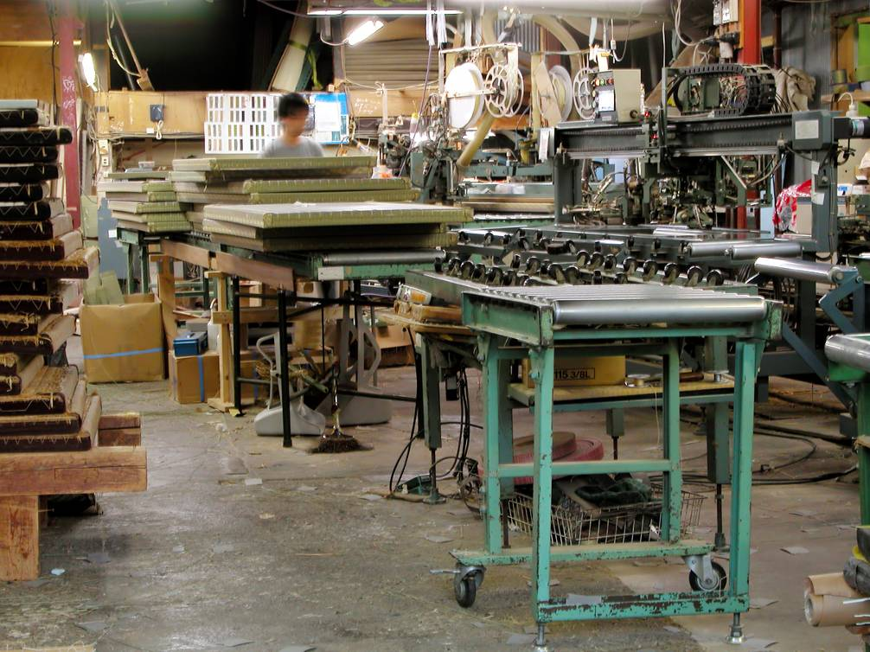
Core Toyota View
“You can understand everything about a company that is important by observing from a good spot on the
plant floor.”
“Data of course is important, but I place greater emphasis
on facts”
- Taiichi Ohno
Reproduced with permission of John Shook, Lean Enterprise Institute

Slide 22
Another take on What is “Lean”?
A true lean system should be:
Simple and practical
Consistently solving real business problems and making improvements in the way work is performed:
  At each level of the company
  In each activity of the company
  In real time
  At the root cause

Slide 23
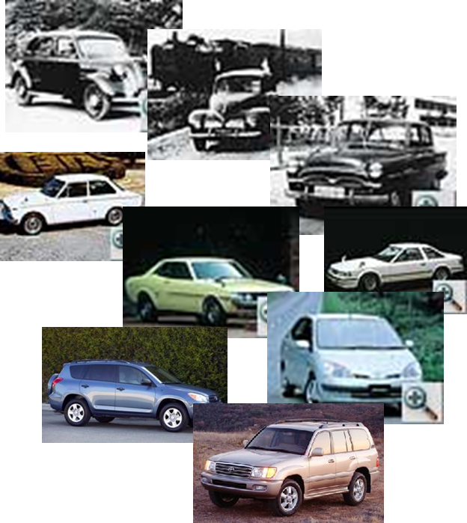
From “LEAN” to “LEARN”
Arguably what Toyota accomplished in its early days that has enabled it to continue to thrive is simply that it learned to learn
Getting people to think and take initiative is they key!
Reproduced with permission of John Shook, Lean Enterprise Institute

Slide 24
Toyota Chairman, Fujio Cho
Fujio Cho, Chairman of Toyota Motor Corp.
“Many good companies try to practice kaizen and use various TPS tools. But what is important is having all the elements together as a system. It must be practiced every day in a very consistent manner – not in spurts – in a concrete way on the shop floor.”
Reproduced with permission of John Shook, Lean Enterprise Institute

Slide 25
Three Phases of Lean Transformation
    The Phase of Simple Kaizen
The Phase of System Implementation
The Phase of Enterprise Transformation
Reproduced with permission of John Shook, Lean Enterprise Institute

Slide 26
Three Phases of Lean Transformation
    The Phase of Simple Kaizen
The Phase of System Implementation
The Phase of Enterprise Transformation
Reproduced with permission of John Shook, Lean Enterprise Institute

Slide 27
The Phase of Simple Kaizen
Aim: Plant floor waste elimination
Characteristic: Fun, freewheeling
Activity: Kaizen “events”
Good: Lots of activity, front line involvement, quick improvement
Typical problems: Kamikaze or Drive-by Kaizen: no systematic rooting out of causes of waste, no system
Reproduced with permission of John Shook, Lean Enterprise Institute

Slide 28
Three Phases of Lean Transformation
    The Phase of Simple Kaizen
The Phase of System Implementation
The Phase of Enterprise Transformation
Reproduced with permission of John Shook, Lean Enterprise Institute

Slide 29
The Phase of System Implementation
Aim: Create a system to eliminate waste systematically
Typical Characteristic: Big programs
Activity: Systematic linking of the tools, binder, CD or Intranet creation, assessment tools, scorecards
Good: System awareness, involvement of some non-production functions, some corporate-wide awareness
Typical problems: Bureaucratic, not “fun”, cost vs. benefit unclear, slow, mid-mgmt stuck in the middle
Reproduced with permission of John Shook, Lean Enterprise Institute

Slide 30
Three Phases of Lean Transformation
    The Phase of Simple Kaizen
The Phase of System Implementation
The Phase of Enterprise Transformation
Reproduced with permission of John Shook, Lean Enterprise Institute

Slide 31
The Phase of Enterprise Transformation
Aim: Survival
Activity: Customer-focused, systematic elimination of sources of waste
Characteristic: Disciplined, demanding, steady, long-term focus
Problem: “Disciplined, demanding, steady, long-term focus…”
Good: Helps organization achieve goals, solving problems, engaging all levels

Slide 32
Most Organizations Struggle
Purpose is not clearly defined in terms of solving the customer’s problems or addressing the business need
Processes are not clearly specified and visible to everyone
People are not engaged in optimizing the whole value stream rather than the point they manage. (And they lack technical competence and a scientific method (PDCA) for improvement)

Slide 33
Review
Objective
Review key learnings from Leadership Lessons from Toyota.
Instructions
Time to Complete
In small groups, discuss each individual’s key
learnings from Leadership Lessons from Toyota, and how you will apply these learnings
beyond this event.
On a sheet of chartpaper, decide on the top 3 key learnings you discussed and report back to
the group.
15 minutes
Deliverable
Report out on group’s
top 3 key learnings.
Notes:
NOTE: Allot 15 minutes for discussion and another 3 minutes per group to report out after the discussion is complete.

Slide 34
Other Modules In This Series:
5S
Standard Work
Total Productive Maintenance (TPM)
Administrative Lean
Cell Design/ Production Preparation Process (3P)
Kaizen
Kanban
Problem Solving
Poka Yoke Quality Systems
Transaction Process Improvement (TPI)
Cause & Effect Diagram with the Additions of Cards (CEDAC)
Single Minute Exchange of Dies (SMED)
Value Stream Mapping (VSMi®)
Visual Management
Managing Daily Process Excellence
For More Information Please Contact:
Mark DeLuzio, President and CEO
+1.860.234.0915
mark.deluzio@leanhorizons.com
Strategically Creating Value Through the Elimination of Waste

